Slide 1
Thickshake Historical Image Classification System
Mark Shelton | 16 February 2018
github.com/markshelton/thickshake
Project sponsored by the Pawsey Supercomputing Centre.

Slide 2
The State Library of Western Australia (SLWA) holds more than one million items in its pictorial collection.
In 2016-17, more than 30,000 items were added to the SLWA’s catalogue. This process is expensive and time-consuming.
Public
Pictorial Item
Triage
Description
Digitisation
Catalogue Record
This is the step we’re interested in augmenting

Slide 3
Contributions
A flexible interface for manipulating library catalogue metadata
A suite of functions that augment library catalogue metadata
A back-end system that leverages high performance computing

Slide 4
Face Detection
Text Recognition
Subject Recognition
Landmark Recognition
Library
Image File
Image Processors
Parallel Store
Machine Learning Classifiers
Pawsey Supercomputing Centre
Storage Interface
Report Writer
Report / Dump
Other Systems
Library
MARC Record
MARC Reader
Relational Database
MARC Writer
Partial MARC Record
Library
Metadata Parsers
Geolocation
Date Extraction
Notes:
Overall architecture

Slide 5
Structure
Library Interface
Metadata Parsing
Image Processing
Machine Learning

Slide 6
Library interface

Slide 7
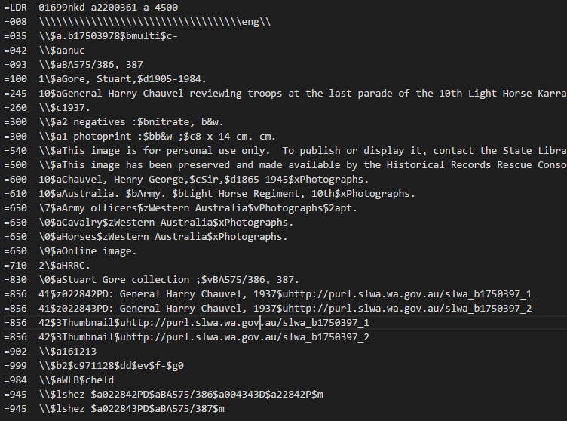

Slide 8
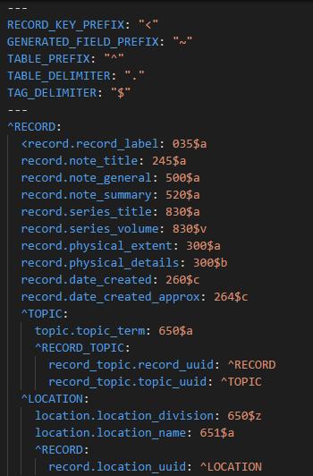
We have developed a system that maps MARC records onto a relational database. The interface works on a user-defined map.

Slide 9
Image
Image URL
Image Title
Image Identifier
Image Embedded Text
Date Created
Image Subject
Face Bounding Box
Building Name
Street Number
Street Name
Street Type
Suburb
State
Country
Latitude
Longitude
Confidence
Subject
Record
Location
Record Subject
Main Subject?
Subject Relationship
Record Title
Record Note
Record Summary
Date Created
Physical Extent
Etc.
Subject Name
Subject Type
Subject Dates
Record Topic
Catalogue Record
Topic
Topic Term

Slide 10
Test Dataset Overview
Records – 3,048
Images – 10,106
Subjects – 4,030
People (2,036)
Top: EL Mitchell, Betty Smith, AH Stone
Topics – 1,722
Top: Interiors, Hotels, Streets

Slide 11
METADATA PARSING

Slide 12
Mappify API
2,500 request limit per day (free)
Based on PSMA G-NAF dataset
Image Title
Parsed Address
Geocoded Address
311688PD: Durham House building premises of Wrightson Dance Studios, The Inn Trim hairdressers, Galore House (no. 842) and Marjorie Young Antiques (no. 836) Hay Street, Perth, December 1982
building_name: None
street_number: ‘836-842’
street_name: 'Hay’
street_type: 'Street'
suburb: 'Perth’
state: 'WA'
location_type: ‘parsed’
building_name: None
street_number: '838-842’
street_name: 'Hay’
street_type: 'Street'
suburb: 'Perth’
post_code: '6000’
state: 'WA'
longitude: 115.85448
latitude: -31.95236,
confidence: 0.05,
location_type: 'geocoded’

Slide 13
Metadata Parsing Wrapper
Input Table: image
Input Columns: [“image note”]
Parser Function: extract location
Parser Arguments: None
Output Table: location
Output Map: {
"index": "image_uuid", "building_name": "building_name", "street_number": "street_number
etc.
}
Database
Input Columns
Output Columns
Parser

Slide 14
IMAGE PROCESSING

Slide 15
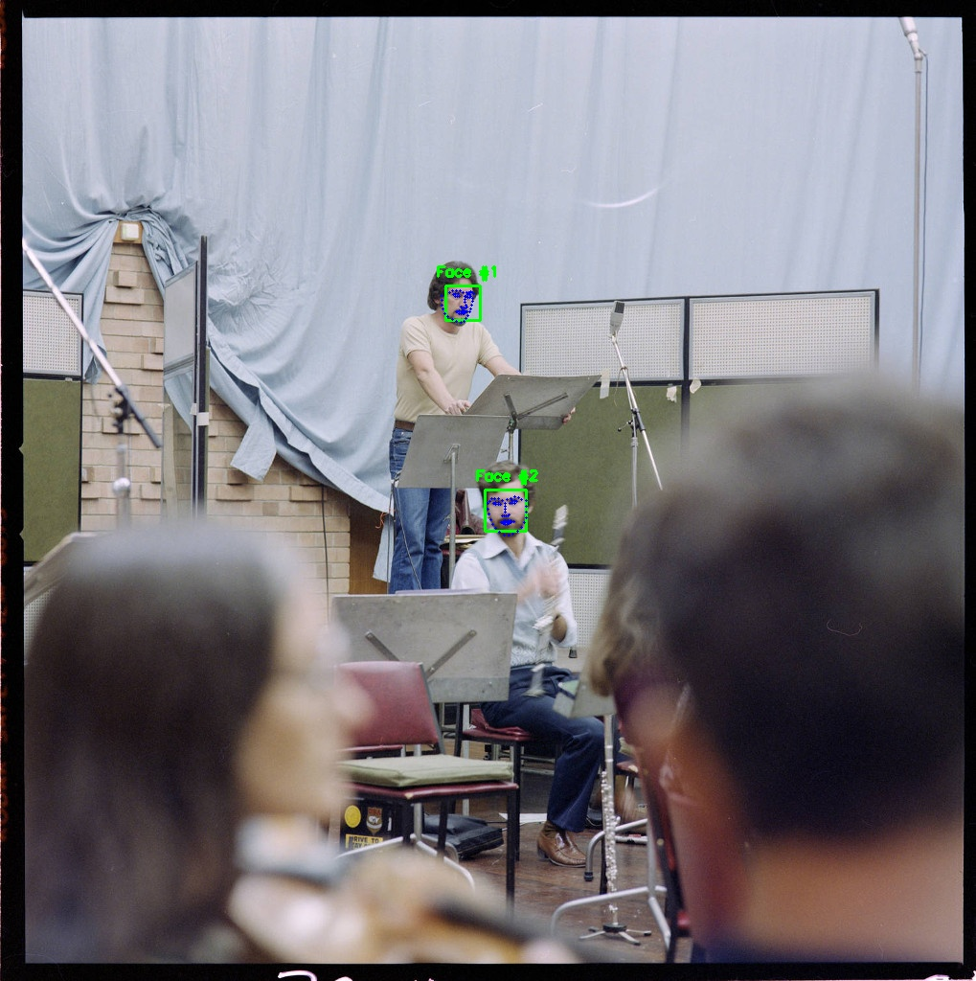
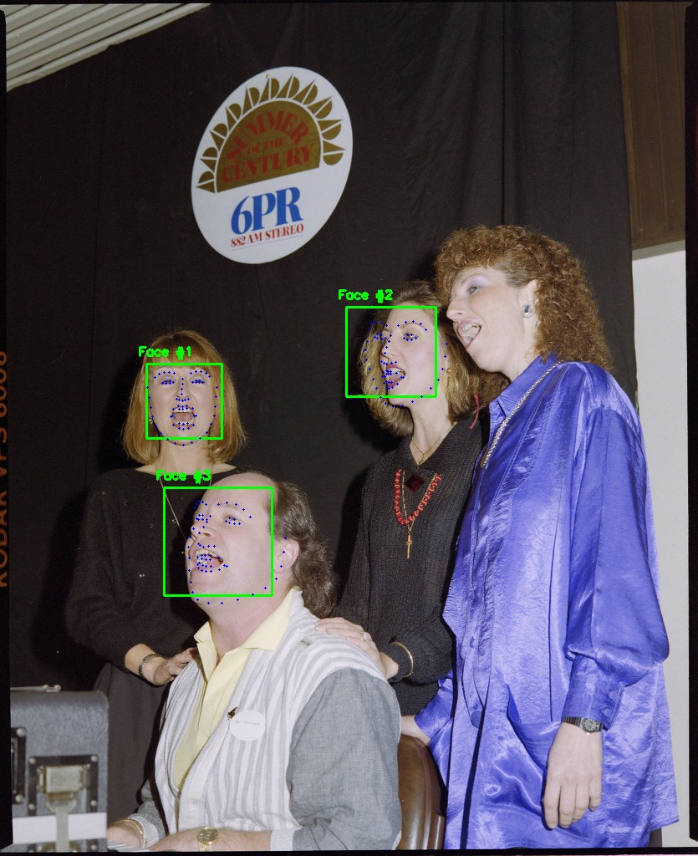
L: Detects principle subjects (at some distance)
R: Misses one principle subject because face is at too extreme an angle
Notes:
Convert Metadata format

Slide 16
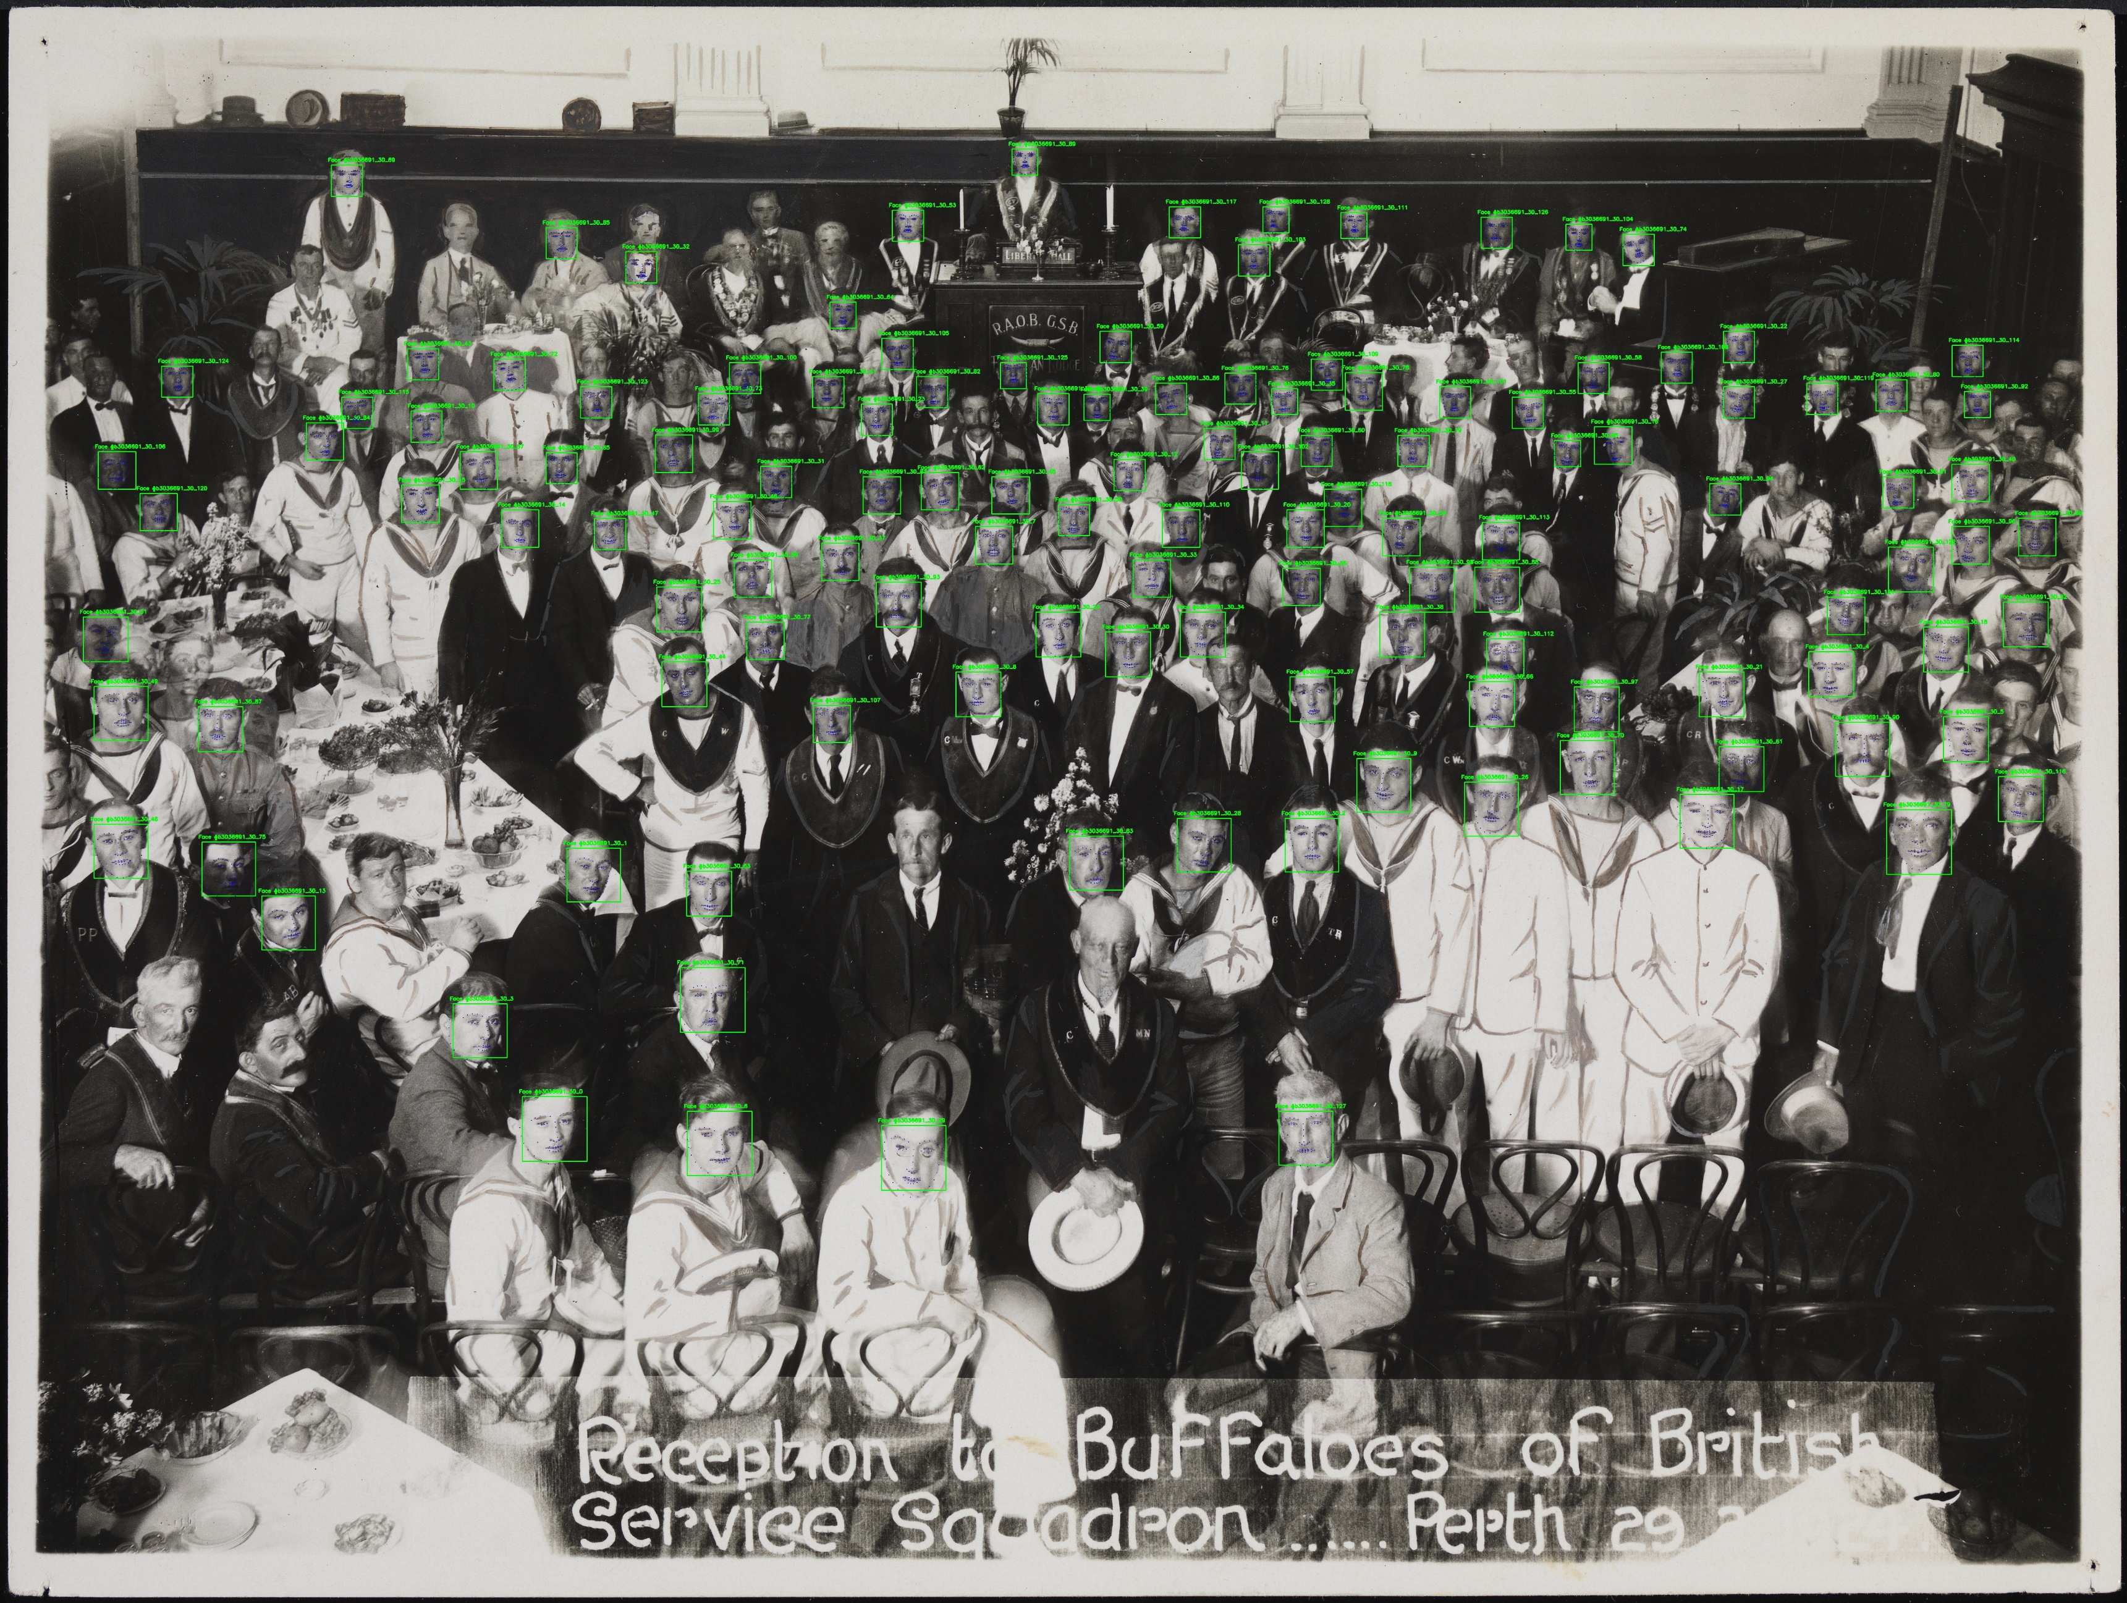
Detects many subjects, but note that this image may confuse classification because it’s a drawing
Notes:
Face detection

Slide 17
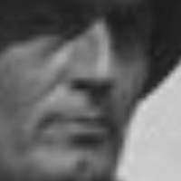
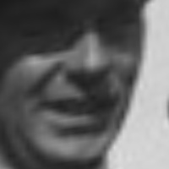
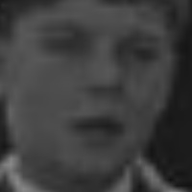
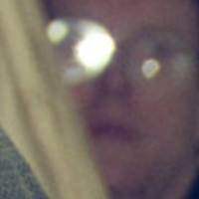
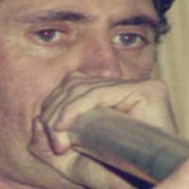
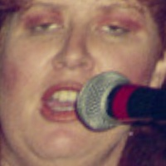
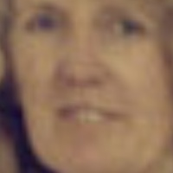
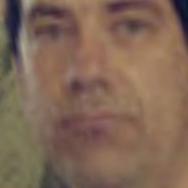
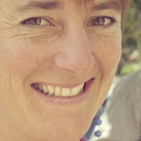
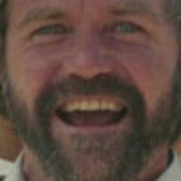

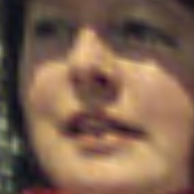
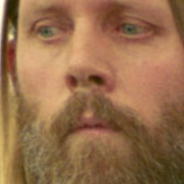
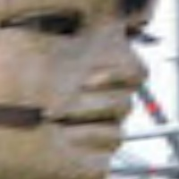
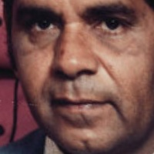
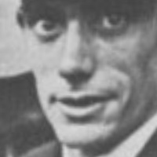
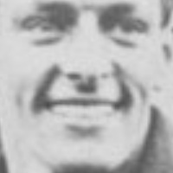

Photo distortion is caused by normalisation – all eyes and lips are moved to the same place.

Slide 18
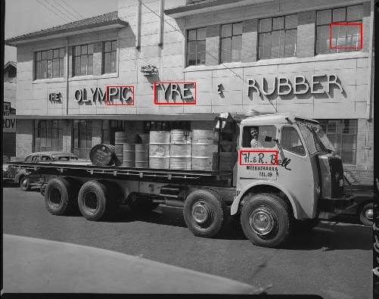
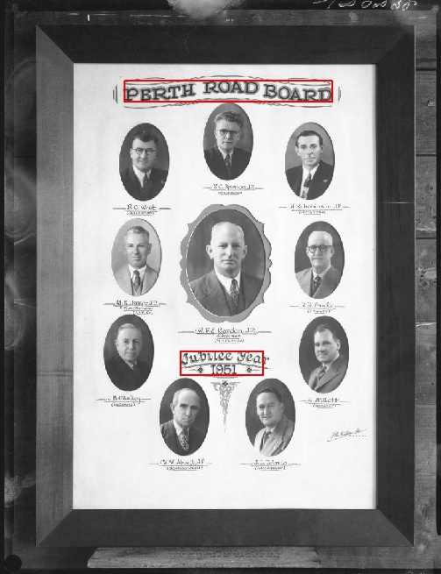
L: Has difficulty detecting low contrast text
R: Detects main headings, individual names are too small

Slide 19
MACHINE LEARNING

Slide 20
Face Predictions
labelpred = labelknown + featuresmetadata + featuresface
Challenges:
Labels are per record (not image) -> uncertainty
Investigating semi-supervised learning
Most subjects have few observations

Slide 21
Processing Tree
Check if store already contains the output of this function
If not:
Check if store contains output of each function dependency
If not: Run dependency function and store output (incrementally)
Run main function and store output (incrementally)
Check if database already contains output of this function
If not: Map each row in store to record in database
Face Recognition
Database Dump
Face Detection
Metadata Parsers

Slide 22
CONCLUSIONS

Slide 23
Automated Build System
Docker-Compose contains:
App Container * Python 3.5
* Tensorflow 1.4.0
* OpenCV 3.3.1
* dlib 19.7
Database Container
* PostgreSQL 10.1
App Container * Python 3.5
* Tensorflow 1.4.0
* OpenCV 3.3.1
* dlib 19.7
Make commands:
make start # loads and builds images, creates volume, creates virtual network
make stop # saves environment, stops containers, removes virtual network
make restart # stops and restarts containers and virtual network
make jupyter # opens jupyter service in default internet browser
make shell # opens interactive session with app container
make push # tags app image and pushes image to DockerHub
Database Container
* PostgreSQL 10.1

Slide 24
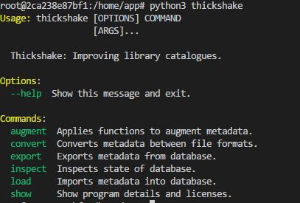
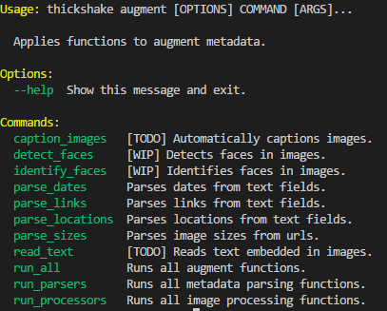
Command Line Interface

Slide 25
Contributions
A flexible interface for manipulating library catalogue metadata
A suite of functions that augment library catalogue metadata
A back-end system that leverages high performance computing

Slide 26
Next Steps
Continue to build machine learning functions (e.g. landmark recognition, image captioning)
Integrate Thickshake with OldPerth to get as much of the catalogue on the map as possible

Slide 27
Thank you …
Joshua Hollick (HIVE, Lead Supervisor)
Andrew Woods (HIVE, Supervisor)
Debra Jones (SLWA, Supervisor)
Sussanah Soon (HIVE, Collaborator)
William Olman (HIVE, Collaborator)
Barbara Patison (SLWA, Advisor)
Adrian Bowen (SLWA, Advisor)
Catherine Kelso (SLWA, Advisor)
David Ong (SLWA, Advisor)
Maciej Cytowski (Pawsey, Advisor)

Slide 28
Thickshake Historical Image Classification System
Mark Shelton | 16 February 2018
github.com/markshelton/thickshake
Project sponsored by the Pawsey Supercomputing Centre.

